Slide 1
Employee Data Analysis using Excel
STUDENT NAME: Athimozhi T
REGISTER NO: 312209964
Email: thamizhaadhimozhi2005@gmail.com
NM ID: 4A483532E0B3CAFB9754BFC6DA071AEF
DEPARTMENT: B.com(General)
COLLEGE: Valliammal College For Women

Slide 2
PROJECT TITLE
Employee Performance Analysis using Excel

Slide 3

AGENDA
Problem Statement
Project Overview
End Users
Our Solution and Proposition
Dataset Description
Modeling Approach
Results and Discussion
Conclusion

Slide 4
PROBLEM STATEMENT
Employee performance analysis identifies strength, weakness, and trends, allowing for more informed decision about training, promotions, and workforce optimization.
It ensures that staffs are in sync with the organization’s aims.
Performance analysis identifies top performers for prospective promotions or prizes.

Slide 5
PROJECT OVERVIEW
The performance analysis assesses workers across company divisions, concentrating on their names, performance levels, and credit scores. It also includes gender statistics to provide a holistic picture of the workforce. Performance levels emphasize individual accomplishments and opportunities for progress, whereas credit ratings demonstrate financial dependability and accountability.
Gender distribution analysis may be used to examine diversity in performance measures. This data helps to identify patterns, give insights into employee capabilities, and assist focused development efforts. Overall, the study helps to make more informed decisions that improve organizational performance and employee growth.

Slide 6

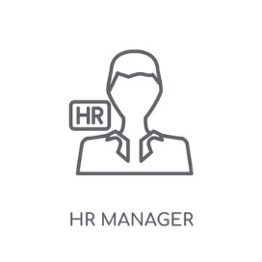




WHO ARE THE END USERS
The end users are:
HR MANAGER EMPLOYEES MANAGER COMPANY
EXECUTIVE
TRANINIG AND DEVELOPMENT
TEAM ORGANIZATONAL PLANNERS

Slide 7

OUR SOLUTION AND ITS VALUE PROPOSITION
Conditional Formatting: To highlight cells.
Sort & Filter: for remove the blank cells and missing values.
Use of Formula: to create new column "performance level" by using credit rating column.
Pivot table: for summery the complicated columns.
slicer: it makes easier to filter the pivot table.
graph: for data visualization.
pie chart: for show the particular data

Slide 8
Dataset Description
Employee Data – from Kaggle.
In that 26 features are given, from that 9 features particularly taken for performance analysis of employee.
They are;
EMPLOYEE ID FIRST NAME LAST NAME BUSINESS UNIT EMPLOYEE TYPE EMPLOYEE CLASSIFICATION TYPE GENDER PERFORMANCE SCORE CURRENT EMPLOYEE RATE PERFORMANCE LEVEL

Slide 9

The wow in our solution
By using credit rating of employee, the performance level have found out.
With the formula:
=IFS(Z9>=5,”VERY HIGH”,Z9>=4,”HIGH”,Z9>=3,”MED”,TRUE,”LOW”)

Slide 10
Modeling Approach
Data collection
Employee data’s collected from kaggle.
Used it on excel.
Features collection
Selected the particular columns – 9 column.
Used conditional formatting for highlighting cells.
Data cleaning
Then filtered the blank cells in “exit date”.
Performance:
1) By using formula, get to know about the performance level of employee.
Summery
Data analysis involves examining, transforming, and modelling data to extract meaningful insights, identify patterns, and support decision-making.

Slide 11
Result: (graph)

Slide 12
Result: (pivot table)
Gender Code | (All)
Count of First Name | Column Labels
Row Labels | HIGH | LOW | MED | VERY HIGH | Grand Total
BPC | 16 | 34 | 85 | 15 | 150
CCDR | 18 | 47 | 65 | 15 | 145
EW | 21 | 41 | 78 | 14 | 154
MSC | 17 | 39 | 92 | 9 | 157
NEL | 21 | 41 | 77 | 15 | 154
PL | 29 | 33 | 69 | 12 | 143
PYZ | 26 | 41 | 75 | 15 | 157
SVG | 26 | 43 | 82 | 16 | 167
TNS | 21 | 45 | 71 | 13 | 150
WBL | 25 | 34 | 84 | 13 | 156
Grand Total | 220 | 398 | 778 | 137 | 1533

Slide 13
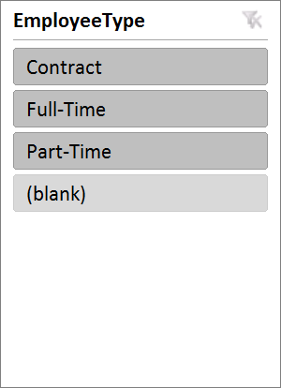
Result : (Slicer & pie chart)

Slide 14
Conclusion
In simple terms, the analysis sought to measure and improve staff productivity using certain assessment indicators. The goal was to discover strengths and opportunities for growth among staff.
The solution required creating a structured feedback system and individualized development strategies to accelerate progress. This technique has resulted in enhanced performance and engagement.
Moving forward, continuous monitoring and modifications will guarantee long-term gains and alignment with company goals.

